Slide 1
Prospective LCI of Direct Air Capture (DAC) product system from 2020-2050

Slide 2
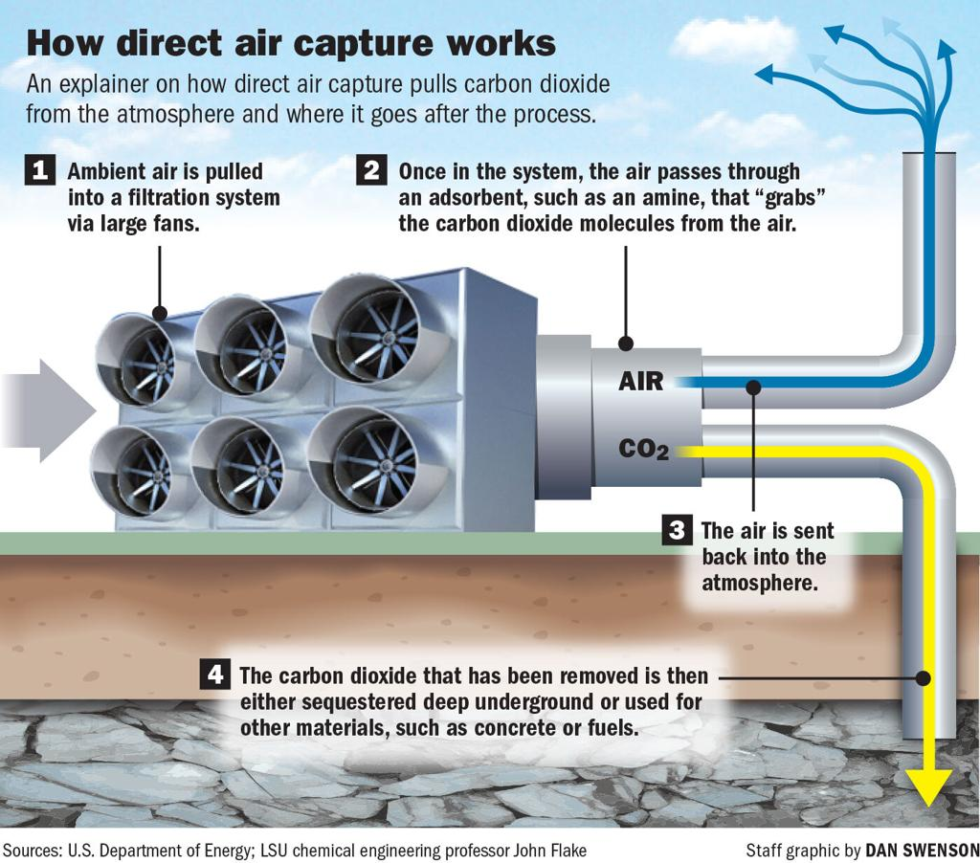
Quick overview:

Slide 3




Single life cycle inventory of DAC product system
Direct Air Capture
System; LCA Model
Life Cycle Inventory (LCI)
CO2 …. g
Air, water
Chemicals ….
1 kg
CH4 …. g
CO2 captured
SO2 …. g
6 MJ
Energy (heat)
0.4 kWh
Coal
Nuclear
…..
……
PV
Electricity
Grid

Slide 4


Prospective life cycle inventory of DAC product system
Direct Air Capture
System; LCA Model
Multiple, future Life Cycle Inventories (LCIs)
CO2 …. g
CO2 …. g
CO2 …. g
Air, water
Chemicals ….
1 kg
CH4 …. g
CH4 …. g
CH4 …. g
CO2 captured
SO2 …. g
SO2 …. g
6.3 MJ…………………5.5 MJ
SO2 …. g
(2020)………………….(2050)
Energy (heat)
0.35kWh ……….. 0.3 kWh
(2020)………….(2050)
Coal
Nuclear
…..
……
PV
17%…..…….... 23%
Electricity
(2020)………….(2050)
Grid
(2020)…………………...(2050)

